Slide 1
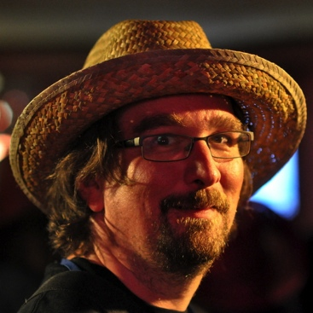

Reduce Politics — Improve Culture
ACE! — 2014 — Krakow — Olaf Lewitz
Licensed under a
Creative Commons
Attribution-NonCommercial-ShareAlike 4.0 International
http://creativecommons.org/licenses/by-nc-sa/4.0/

Slide 2
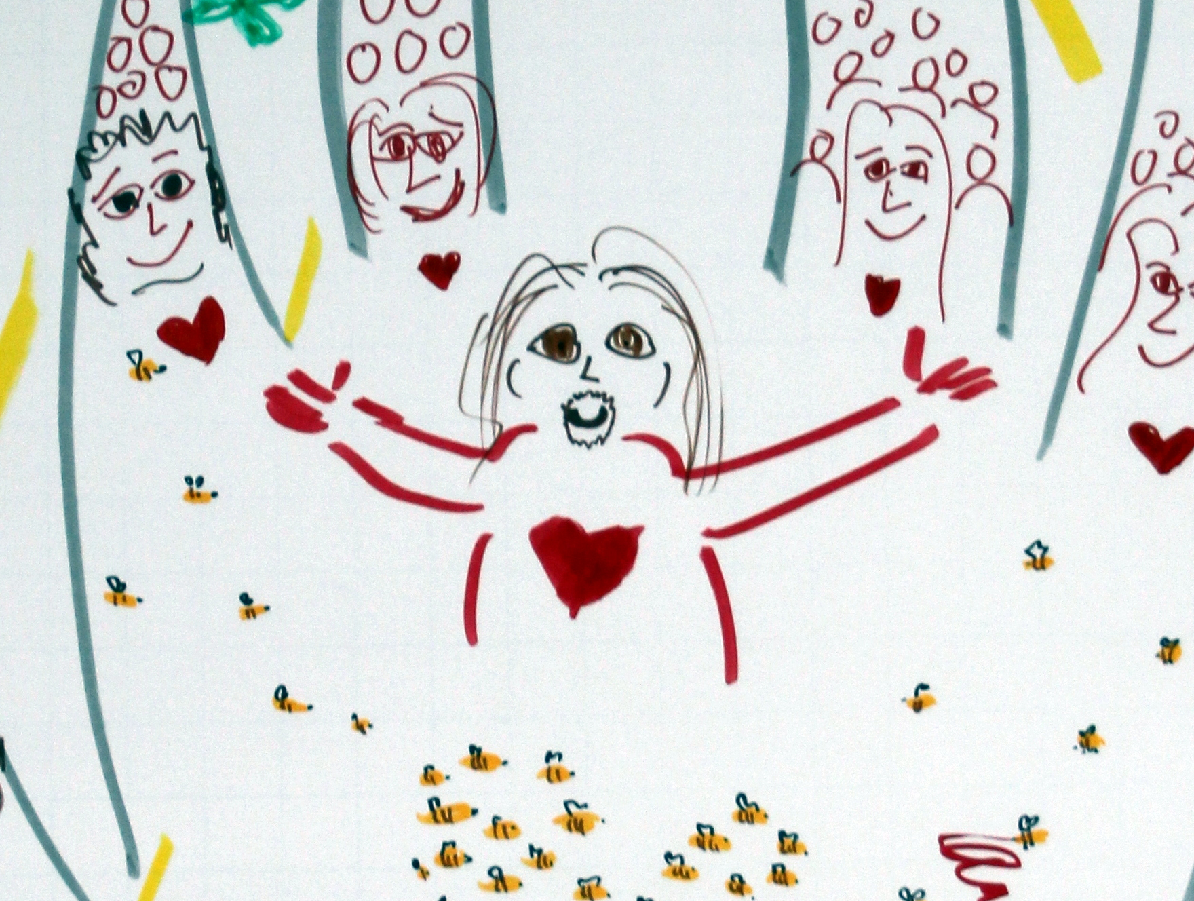
Notes:
Introduce myself – how I learned to dare talk about love at work

Slide 3
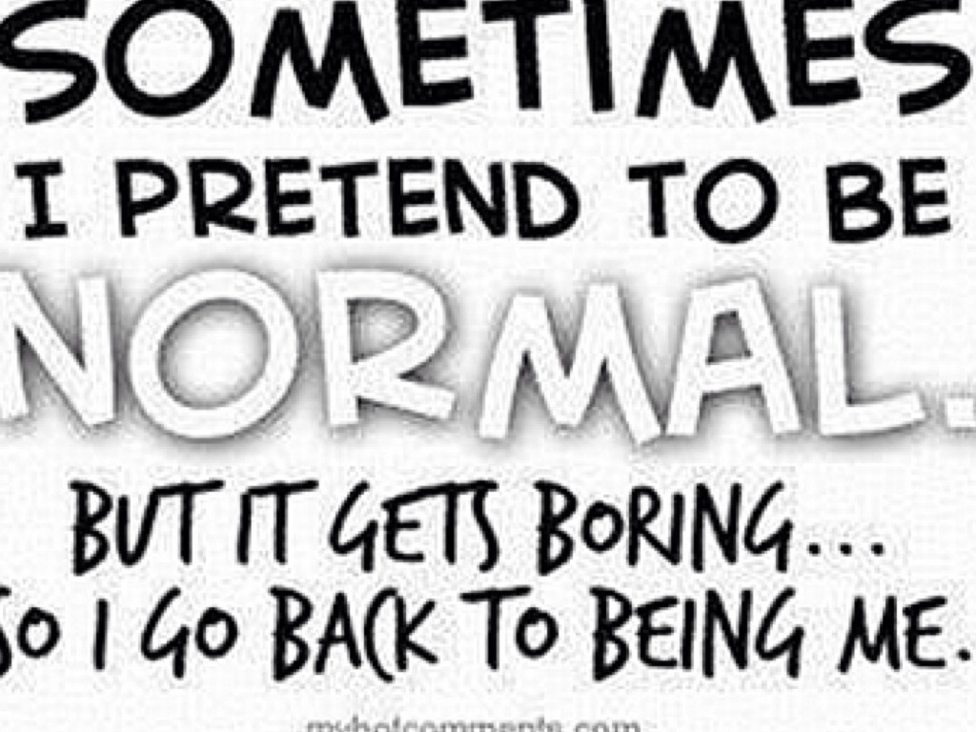
Photo by marsmet531 - Creative Commons Attribution-NonCommercial-ShareAlike License http://www.flickr.com/photos/87764589@N07
Created with Haiku Deck

Slide 4
You Deserve To Love What You Do And Be Loved For What You Do

Slide 5

@OlafLewitz
http://trustartist.com
UNLEASHING WHOLEHEARTEDNESS IN ORGANISATIONS

Slide 6


Slide 7
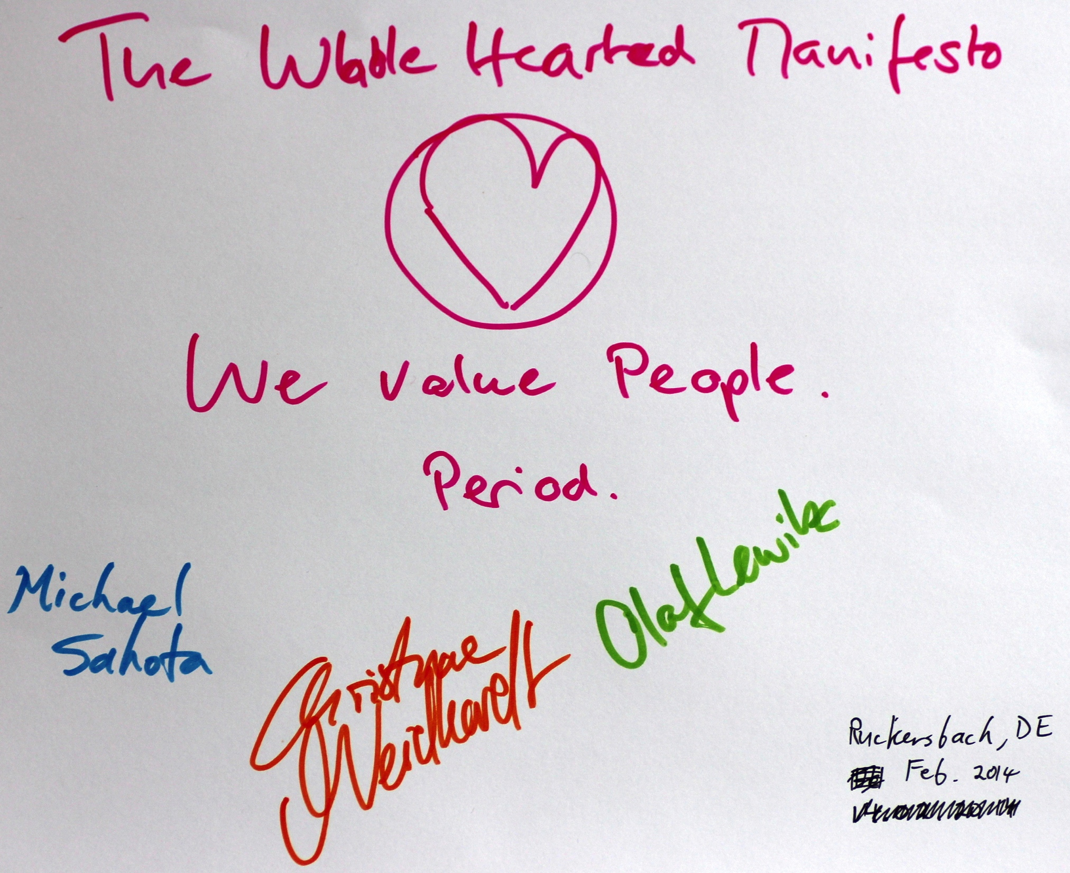

Slide 8
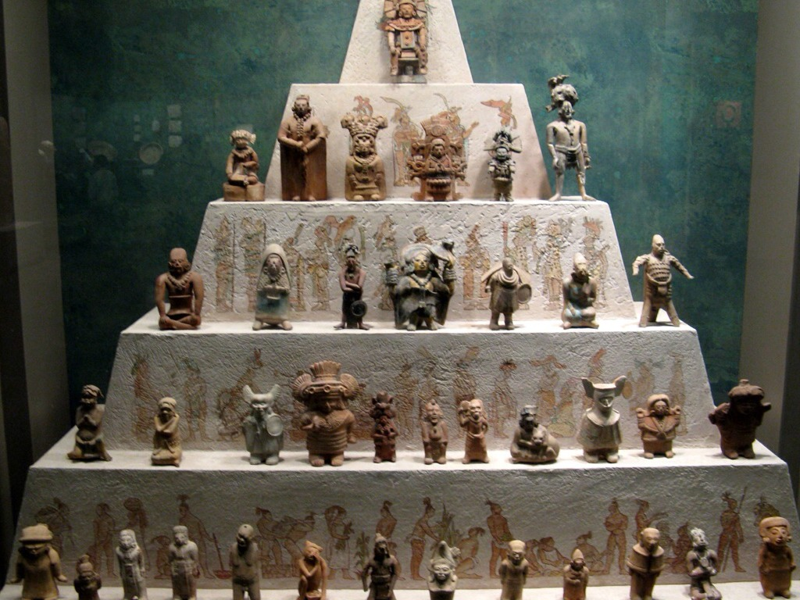
system
Photo by Travis S. - Creative Commons Attribution-NonCommercial License http://www.flickr.com/photos/51378257@N00
Created with Haiku Deck
Notes:
Most of us underestimate their ability to change the system

Slide 9
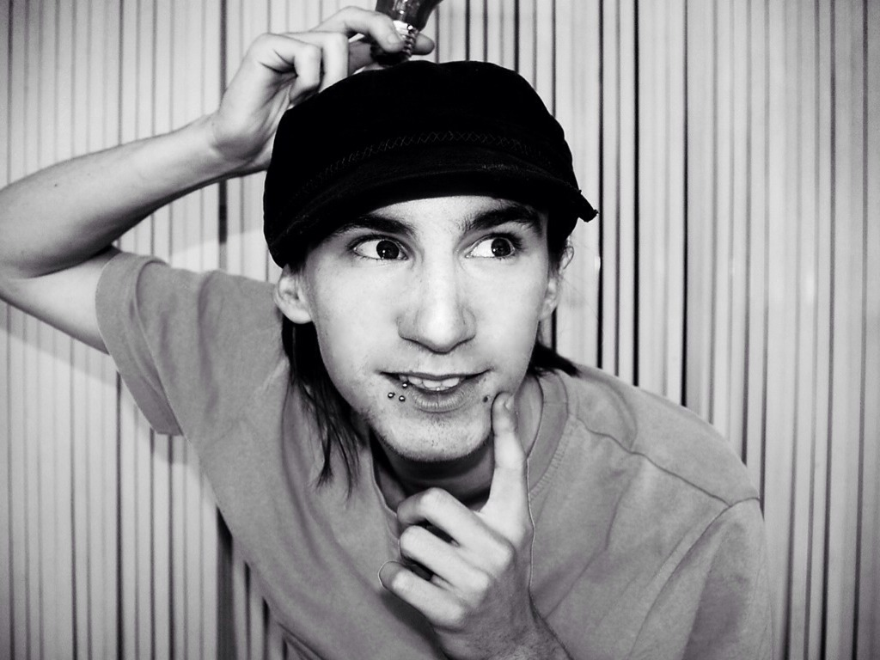
individual
Photo by Adriano Agulló - Creative Commons Attribution License http://www.flickr.com/photos/21770219@N04
Created with Haiku Deck
Notes:
because most of us underestimate the ability to change ourselves

Slide 10
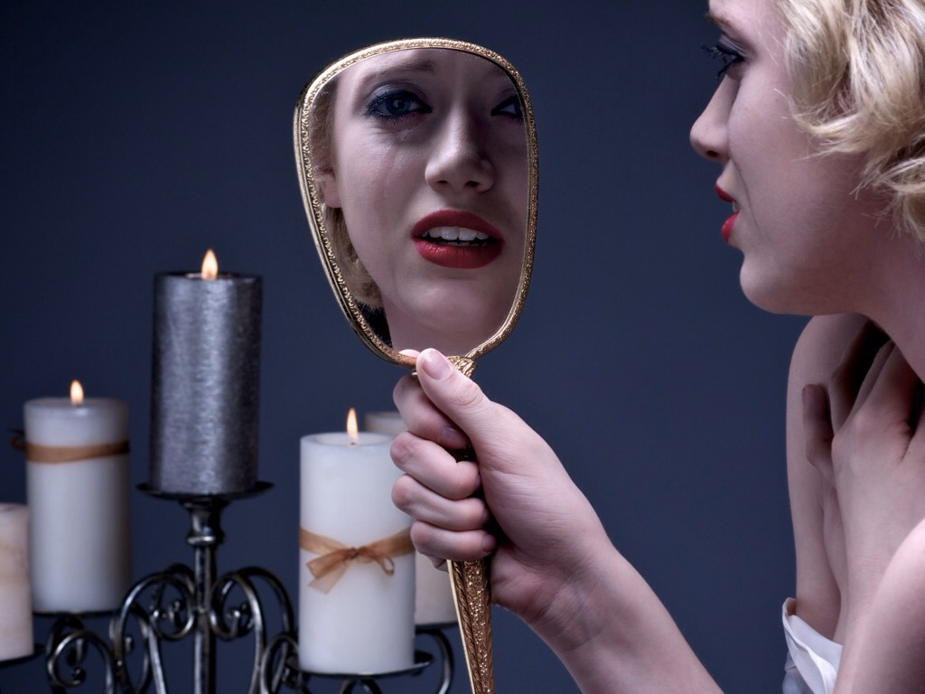
Photo by dualdflipflop - Creative Commons Attribution License http://www.flickr.com/photos/63106298@N02
Created with Haiku Deck
Notes:
We rarely dare to honestly look at ourselves

Slide 11
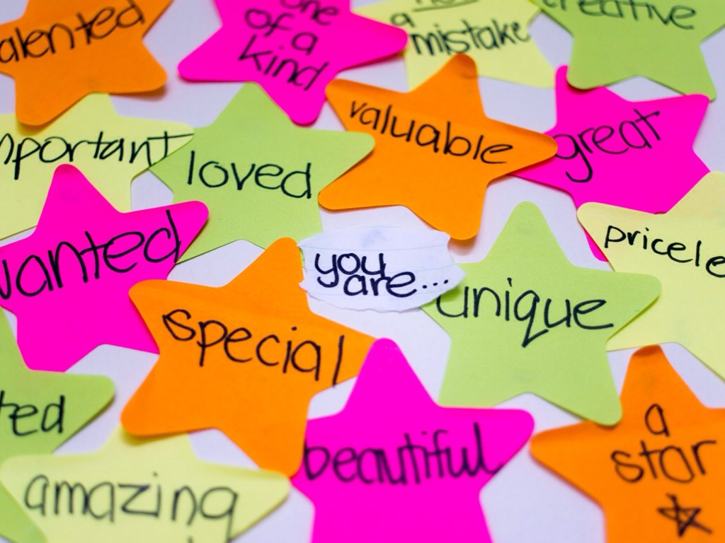
Photo by Key Foster - Creative Commons Attribution License http://www.flickr.com/photos/61411590@N03
Created with Haiku Deck
Notes:
we don't think we deserve to be special – we lack self-worth and self-kindness

Slide 12
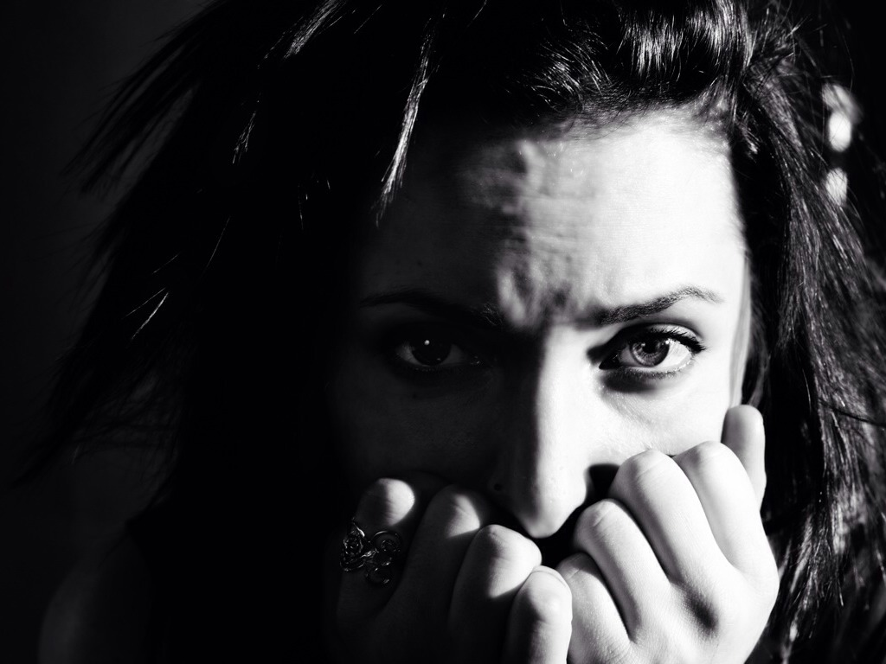
FEAR
Photo by Kevin Gebhardt - Creative Commons Attribution-NonCommercial-ShareAlike License http://www.flickr.com/photos/31545680@N03
Created with Haiku Deck
Notes:
We spend a lot of our time and energy dealing with fear.

Slide 13
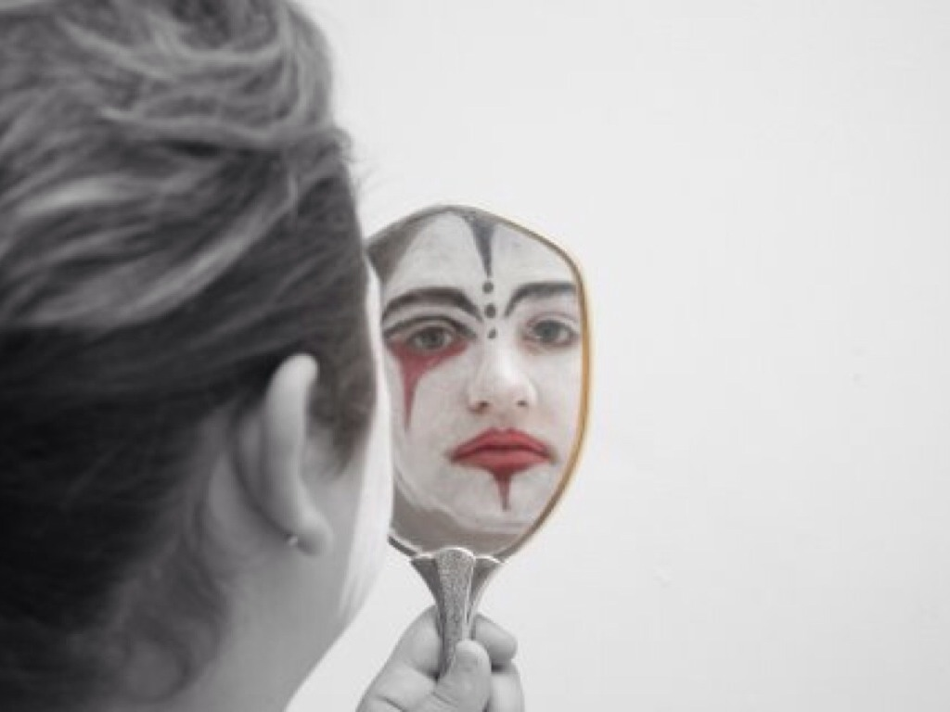
Authenticity
Photo by Nina Matthews Photography - Creative Commons Attribution License http://www.flickr.com/photos/21560098@N06
Created with Haiku Deck
Notes:
We trade in authenticity...

Slide 14
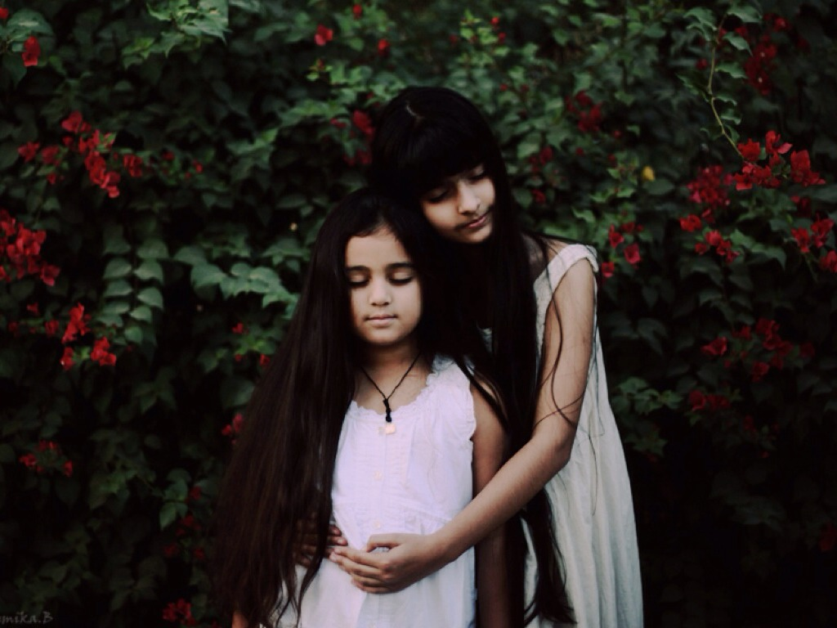
Attachment
Photo by Bhumika.B - Creative Commons Attribution License http://www.flickr.com/photos/35092017@N03
Created with Haiku Deck
Notes:
For attachment

Slide 15
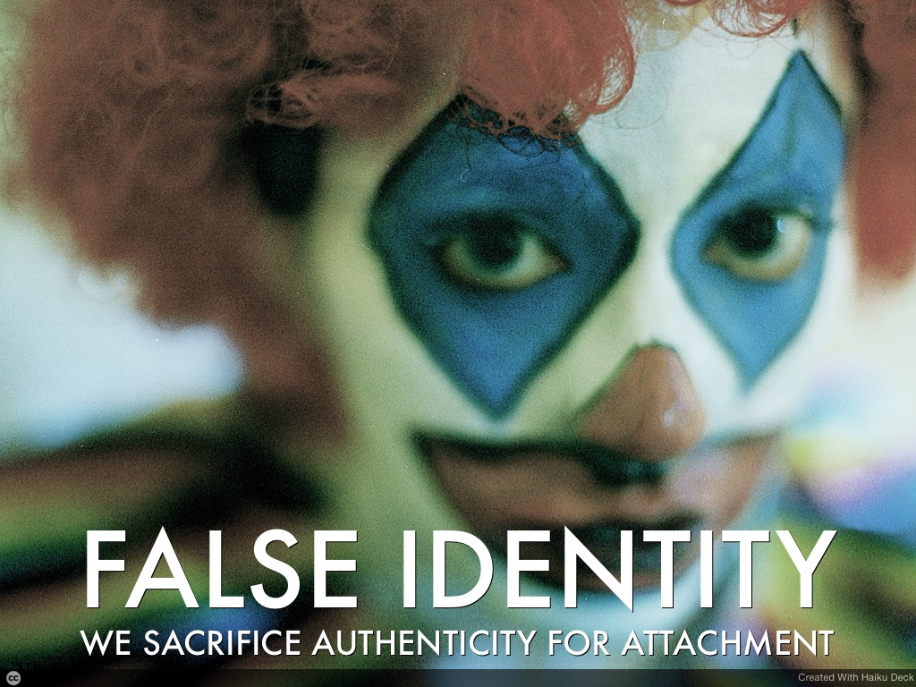

Slide 16
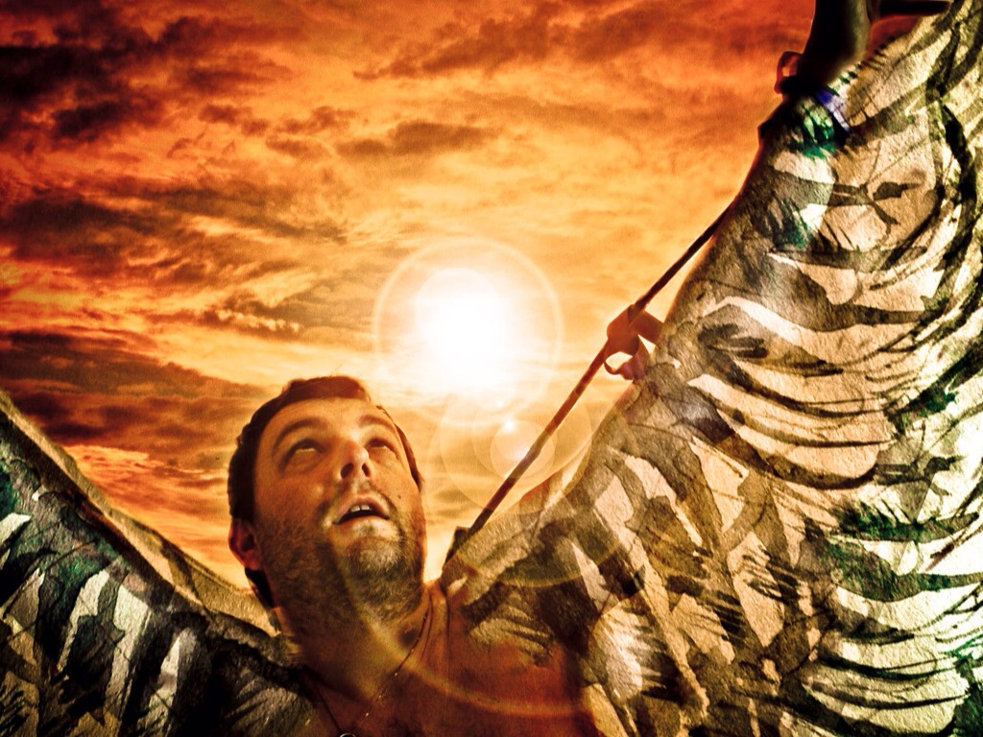
FREEDOM
Photo by practicalowl - Creative Commons Attribution-NonCommercial License http://www.flickr.com/photos/55046645@N00
Created with Haiku Deck
Notes:
We‘re told not to fly to high (nobody tells us that Icarus‘ father also advised him not to fly too low...) We trade in our freedom ...

Slide 17

SAFETY
Photo by lensbug.chandru - Creative Commons Attribution License http://www.flickr.com/photos/67243694@N00
Created with Haiku Deck
Notes:
For the safety of belonging to a tribe

Slide 18
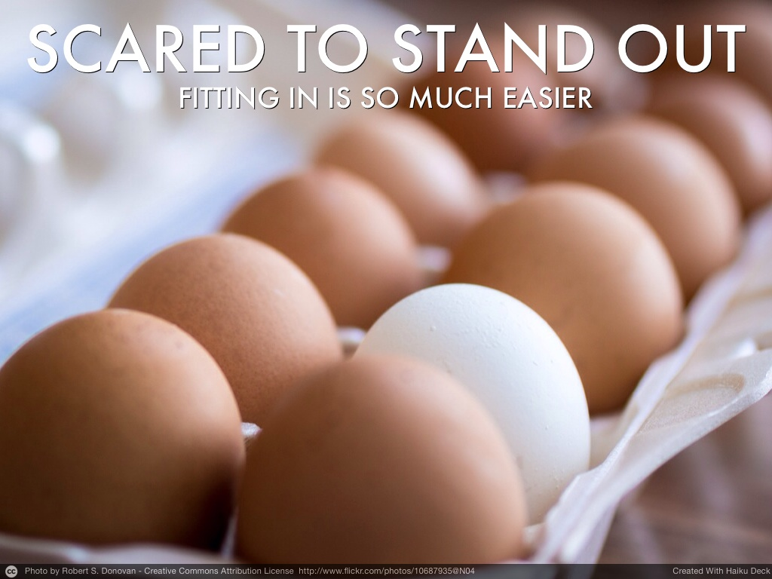
Notes:
This gift has two faces:

Slide 19
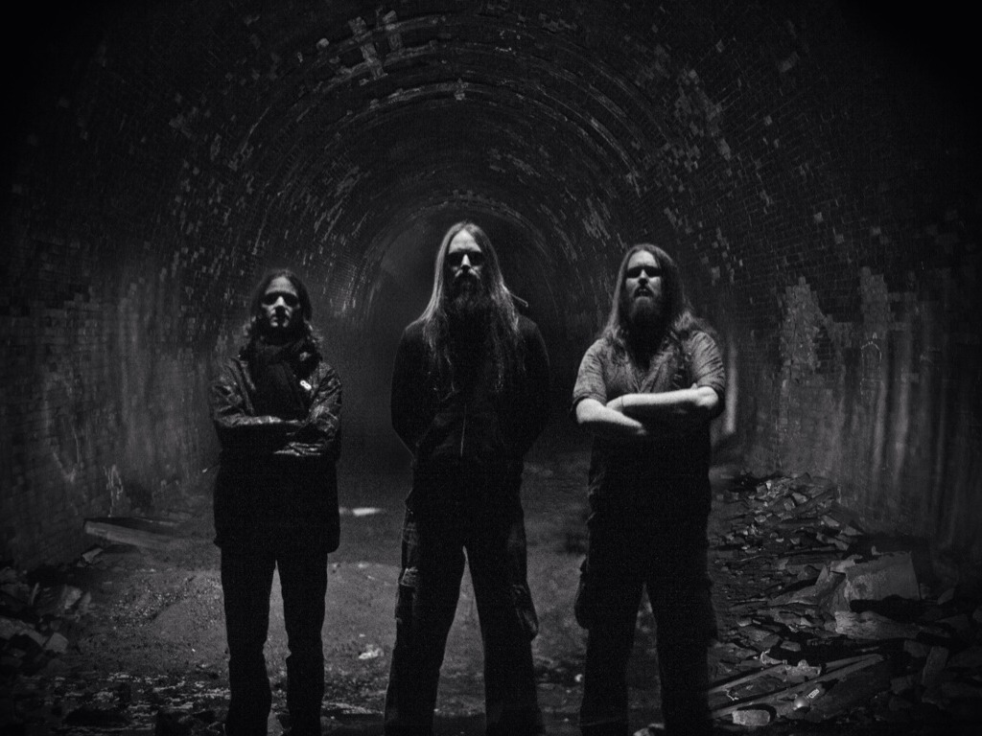
JUDGEMENT
Photo by Keane Beamish - Creative Commons Attribution-NonCommercial-ShareAlike License http://www.flickr.com/photos/7957394@N03
Created with Haiku Deck
Notes:
Right and wrong, good and bad ...

Slide 20
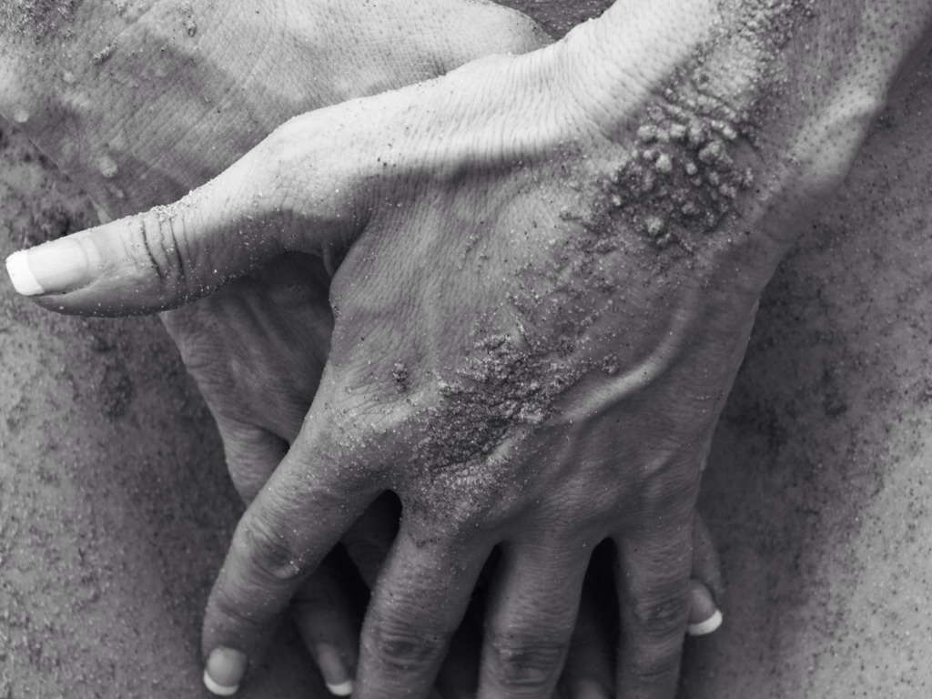
SHAME
Photo by Jay Aremac - Creative Commons Attribution License http://www.flickr.com/photos/63155157@N03
Created with Haiku Deck
Notes:
Shame keeps us small

Slide 21
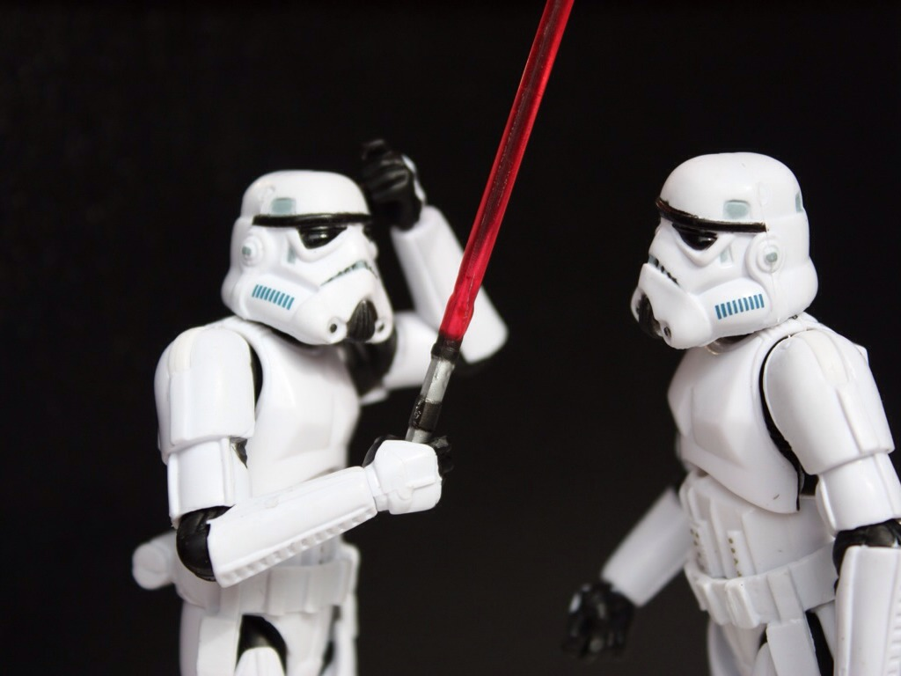
Oppression
Photo by Stéfan - Creative Commons Attribution-NonCommercial-ShareAlike License http://www.flickr.com/photos/49462908@N00
Created with Haiku Deck
Notes:
The result is oppression.

Slide 22
OPPRESSION
“Oppression is a relationship in which there is only monologue, not dialogue.”
Augusto Boal

Slide 23
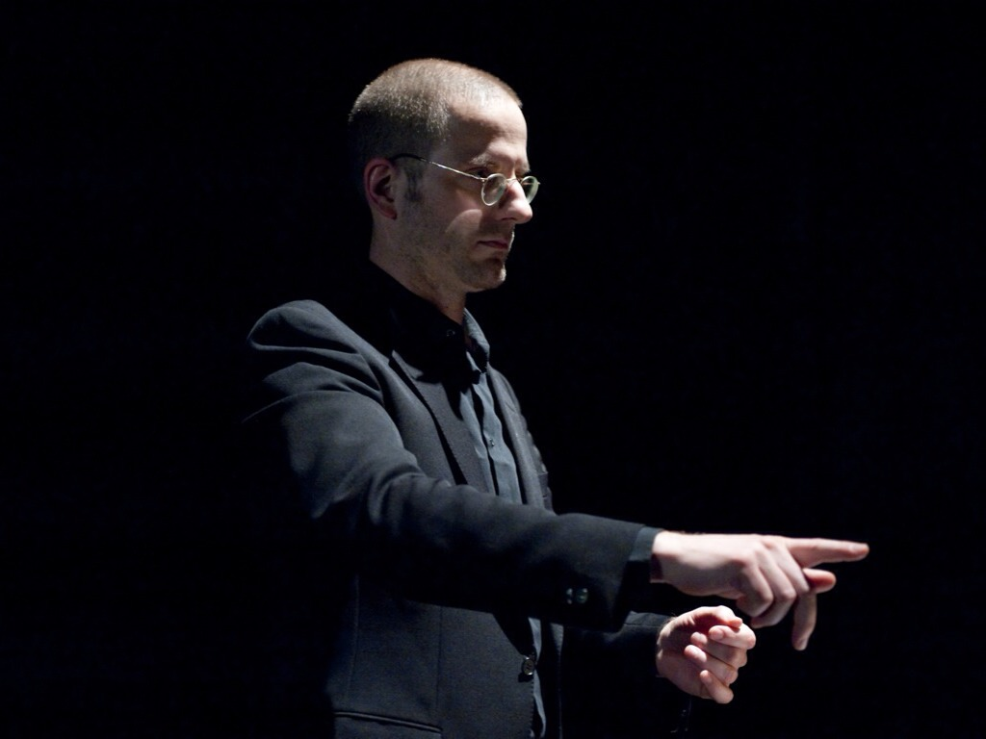
Photo by Theater der Künste - Creative Commons Attribution License http://www.flickr.com/photos/31427152@N04
Created with Haiku Deck
Notes:
They tell you: you have to ... You should ... You can‘t ...

Slide 24
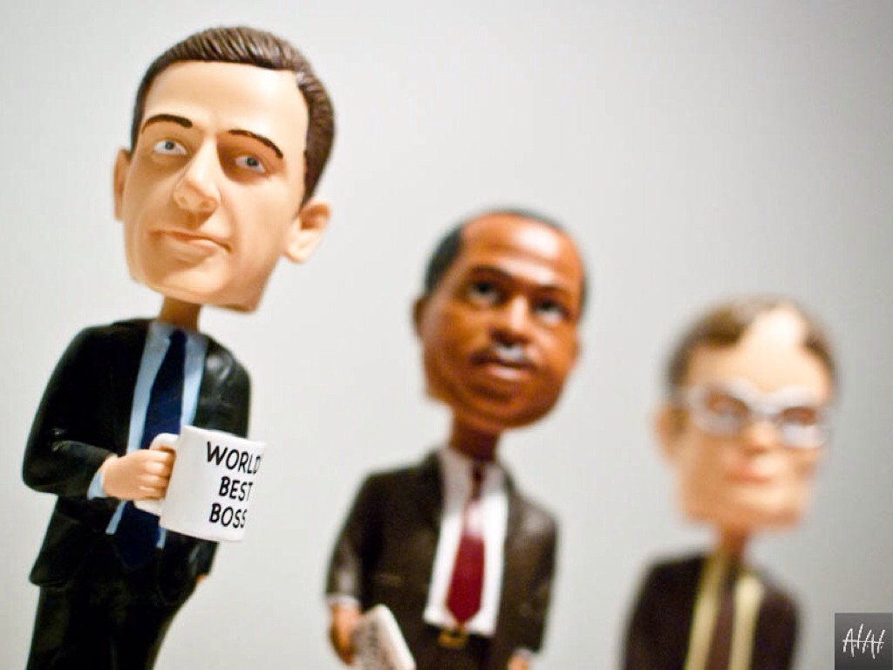
Politics
Photo by AhmadHashim - Creative Commons Attribution-NonCommercial-ShareAlike License http://www.flickr.com/photos/51052219@N00
Created with Haiku Deck
Notes:
The product of judgment and shame, of trading authenticity for success, is politics.

Slide 25
Cover Thine Arse
1st Commandment of Corporate Politics

Slide 26
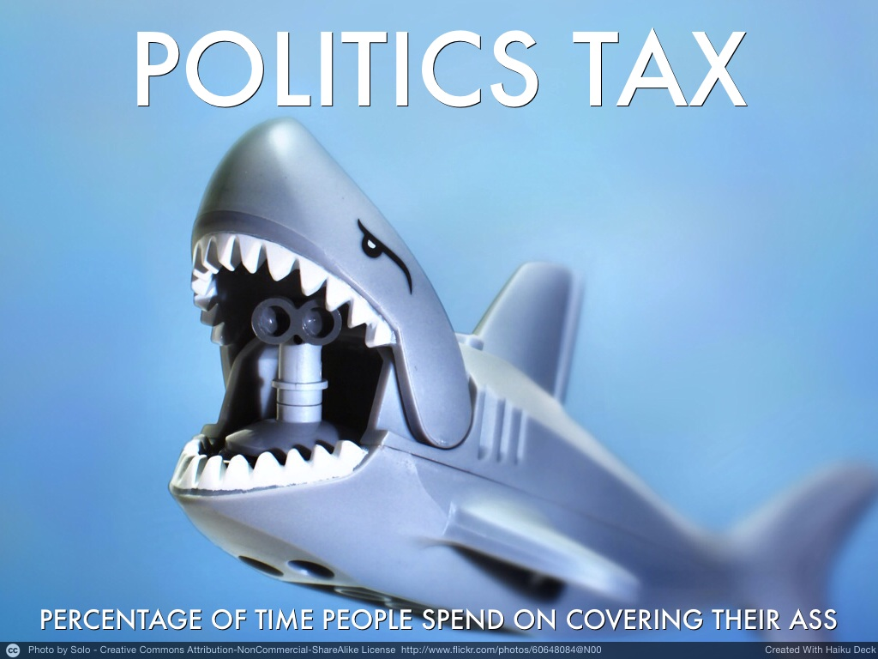
Idea by
Michael Sahota

Slide 27
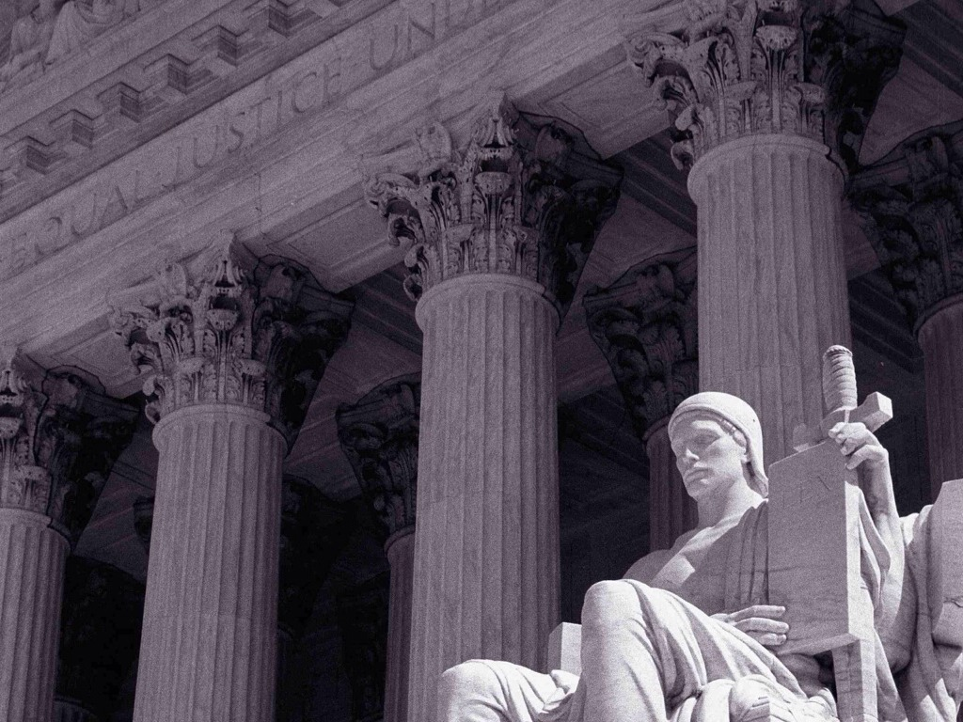
How much energy do you use to ... Make sure you look good? ... Ensure it‘s not your fault? ... Bend data to fit expectations? ... Cover up bad news? ... Cover thine arse?
Photo by David Paul Ohmer - Creative Commons Attribution License http://www.flickr.com/photos/50965924@N00
Created with Haiku Deck

Slide 28
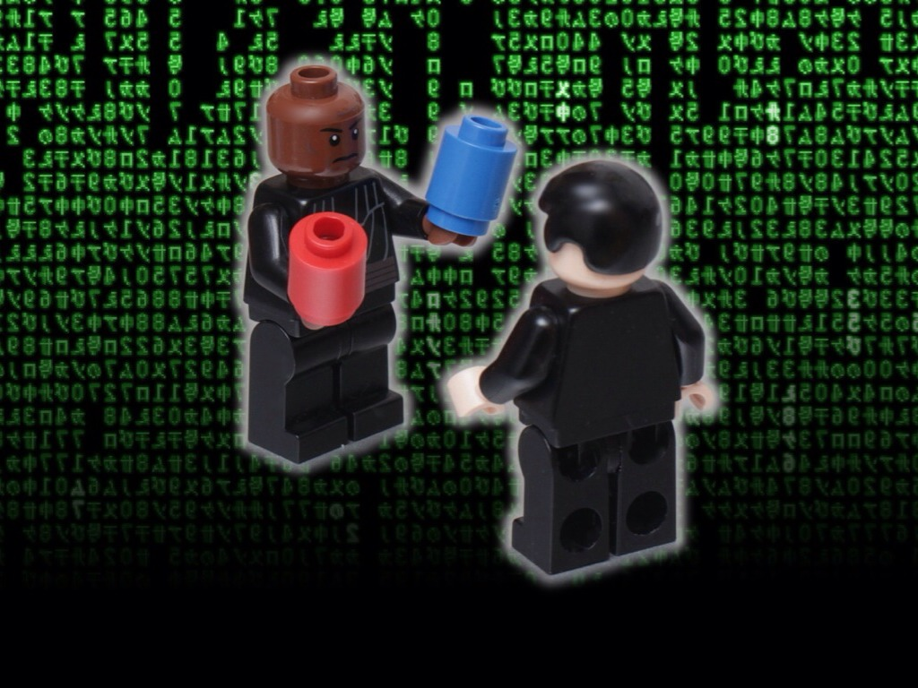
CHOICE
Photo by pasukaru76 - Creative Commons Attribution License http://www.flickr.com/photos/38451115@N04
Created with Haiku Deck
Notes:
Do we take the blue pill, and continue improving the mechanics of oppression: rules, roles, processes, organisational structure...

Slide 29
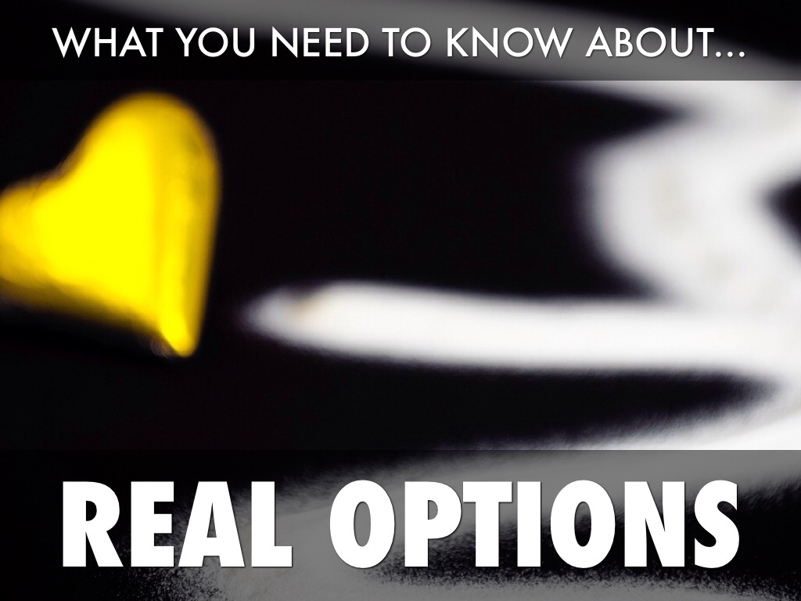
Photo by Matthias Rhomberg - Creative Commons Attribution License http://www.flickr.com/photos/33772123@N03
Created with Haiku Deck

Slide 30
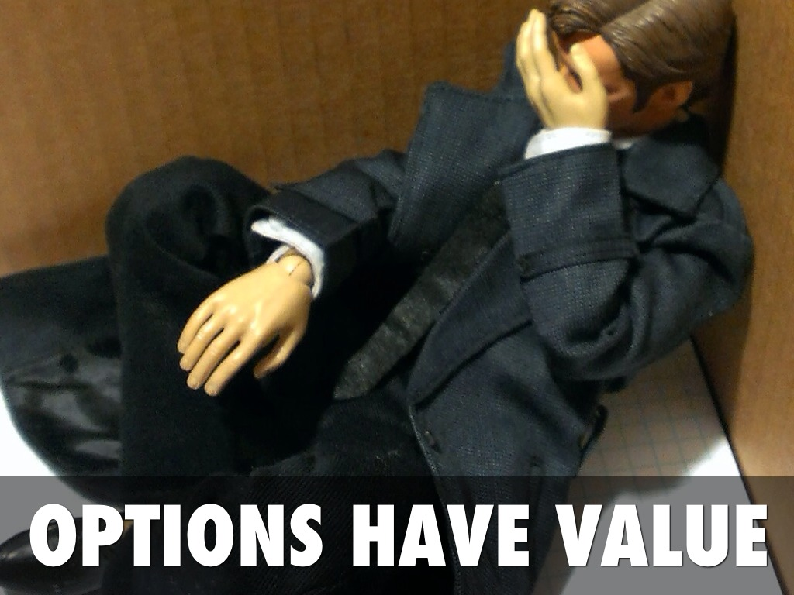
Photo by natalia love - Creative Commons Attribution-NonCommercial License http://www.flickr.com/photos/87718749@N00
Created with Haiku Deck

Slide 31
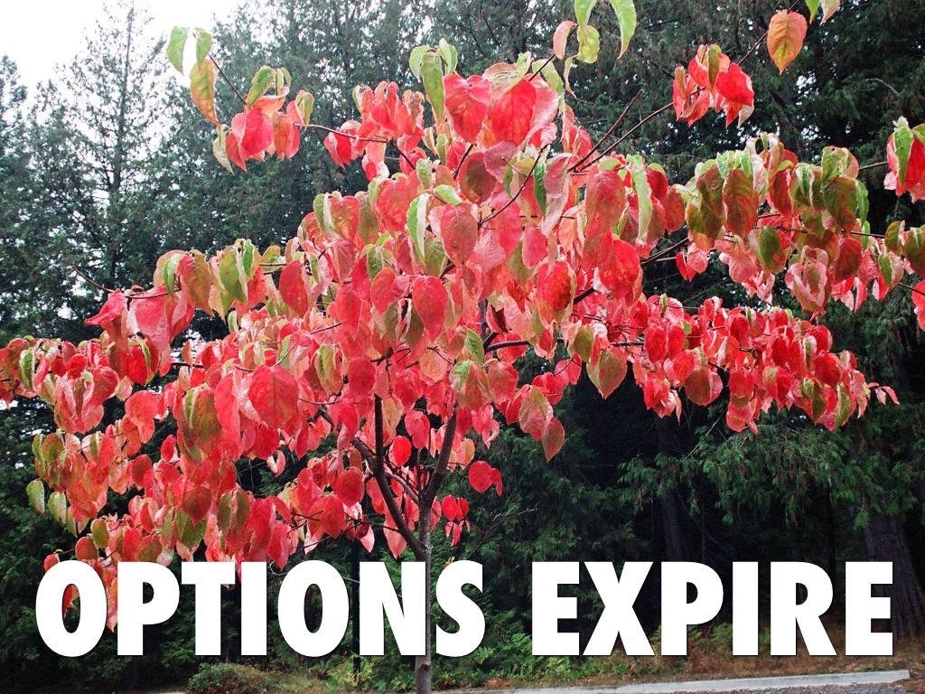
Photo by Stoic Meditation - Creative Commons Attribution-NonCommercial-ShareAlike License http://www.flickr.com/photos/63463553@N07
Created with Haiku Deck

Slide 32
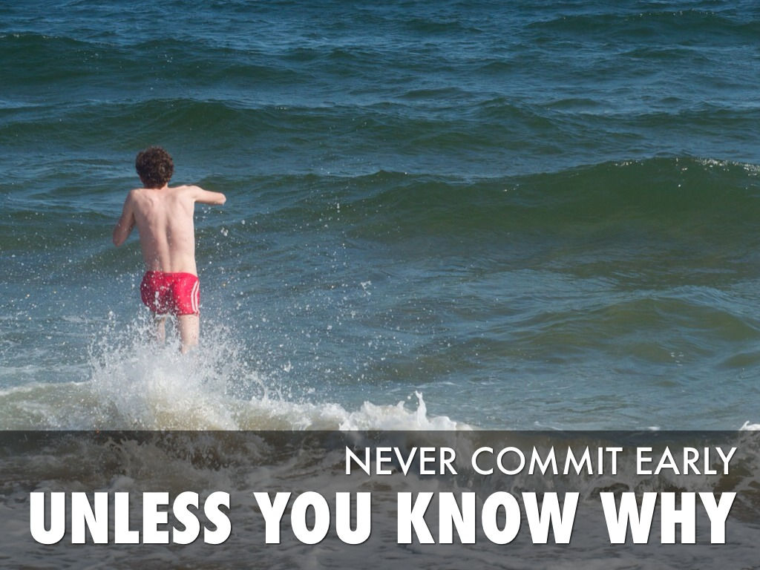
Photo by hynkle - Creative Commons Attribution-NonCommercial-ShareAlike License http://www.flickr.com/photos/93352468@N00
Created with Haiku Deck

Slide 33

Let Things Emerge
Photo by erin leigh mcconnell - Creative Commons Attribution License http://www.flickr.com/photos/59521823@N00
Created with Haiku Deck

Slide 34

Trust that what can happen will happen
Photo by kennymatic - Creative Commons Attribution License http://www.flickr.com/photos/99472898@N00
Created with Haiku Deck

Slide 35
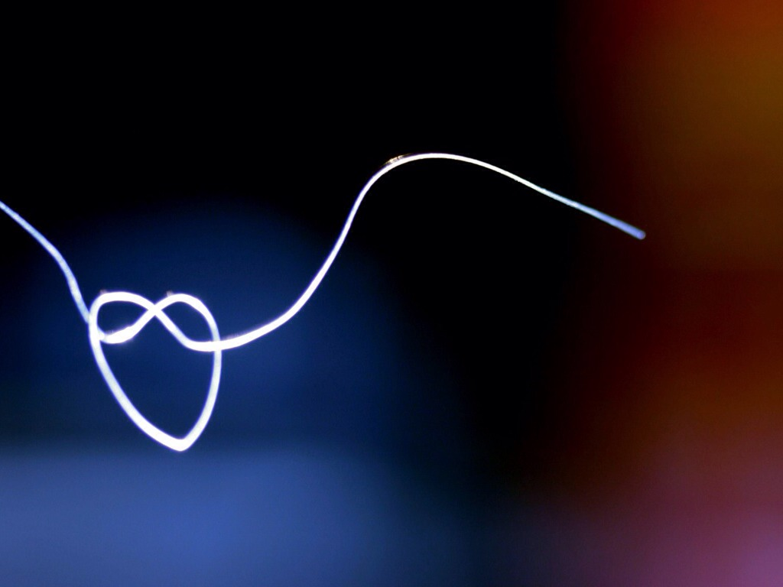
Run experiments and celebrate failure
Photo by Neal. - Creative Commons Attribution License http://www.flickr.com/photos/31878512@N06
Created with Haiku Deck

Slide 36
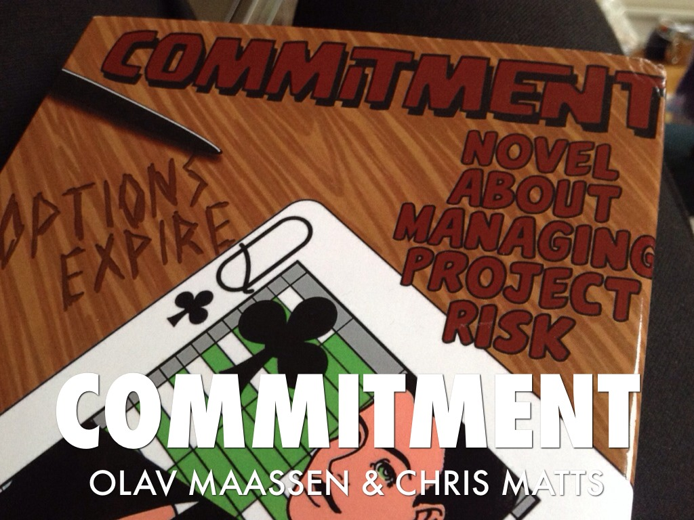

Slide 37
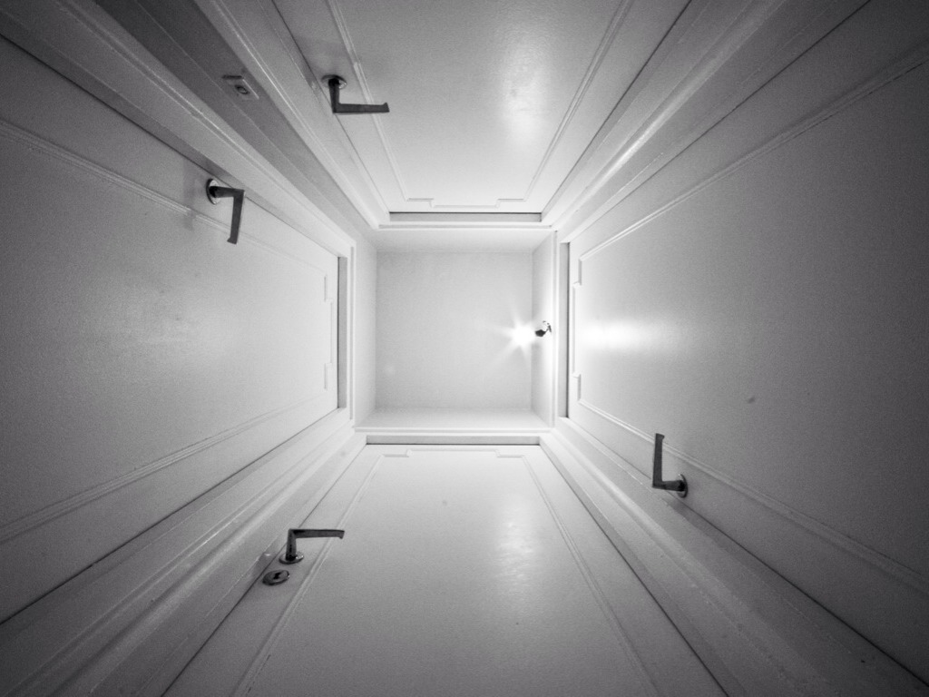
What are our Options?
Photo by xo-mox - Creative Commons Attribution-NonCommercial-ShareAlike License http://www.flickr.com/photos/26225637@N08
Created with Haiku Deck

Slide 38
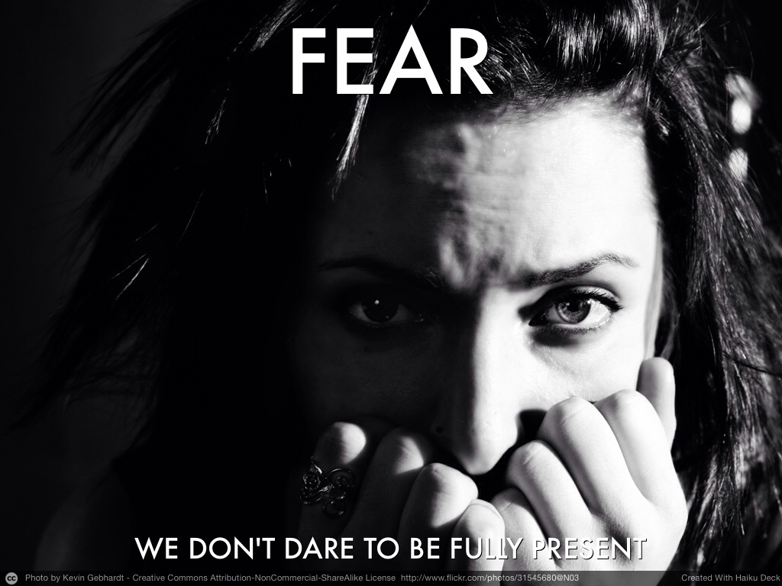
Notes:
What if we‘re afraid of our options? How do we overcome the fear?

Slide 39
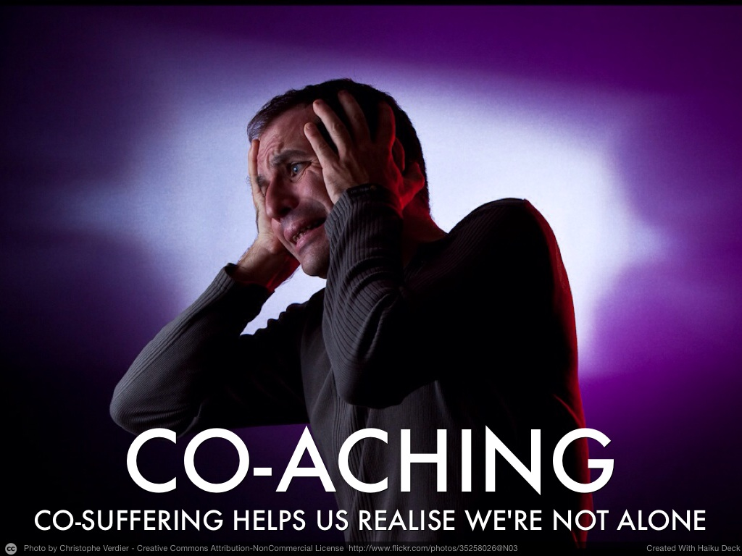

Slide 40
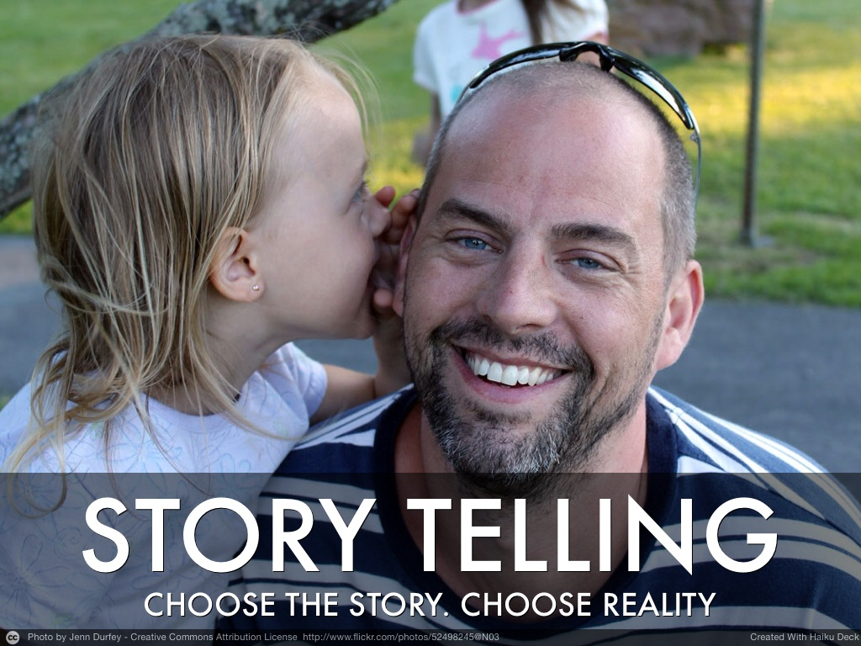

Slide 41
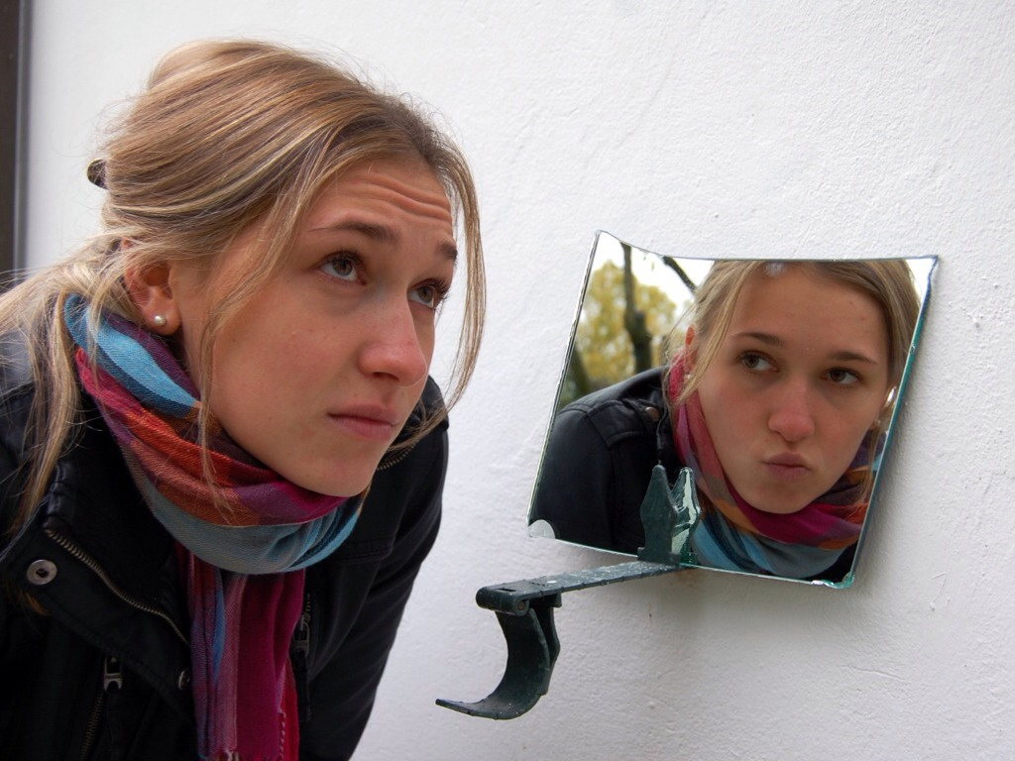
Change Your Perspective.
Photo by ЕленАндреа - Creative Commons Attribution-ShareAlike License http://www.flickr.com/photos/14901566@N07
Created with Haiku Deck
Notes:
Change your perspective. Change your reality. Change your story...

Slide 42
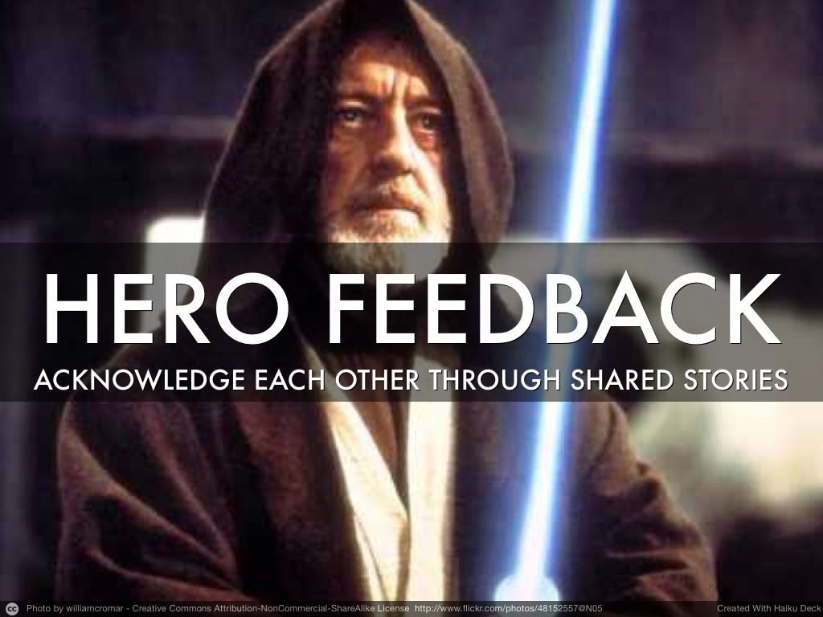
Notes:
Pick a hero. For your story or for someone else‘s.

Slide 43
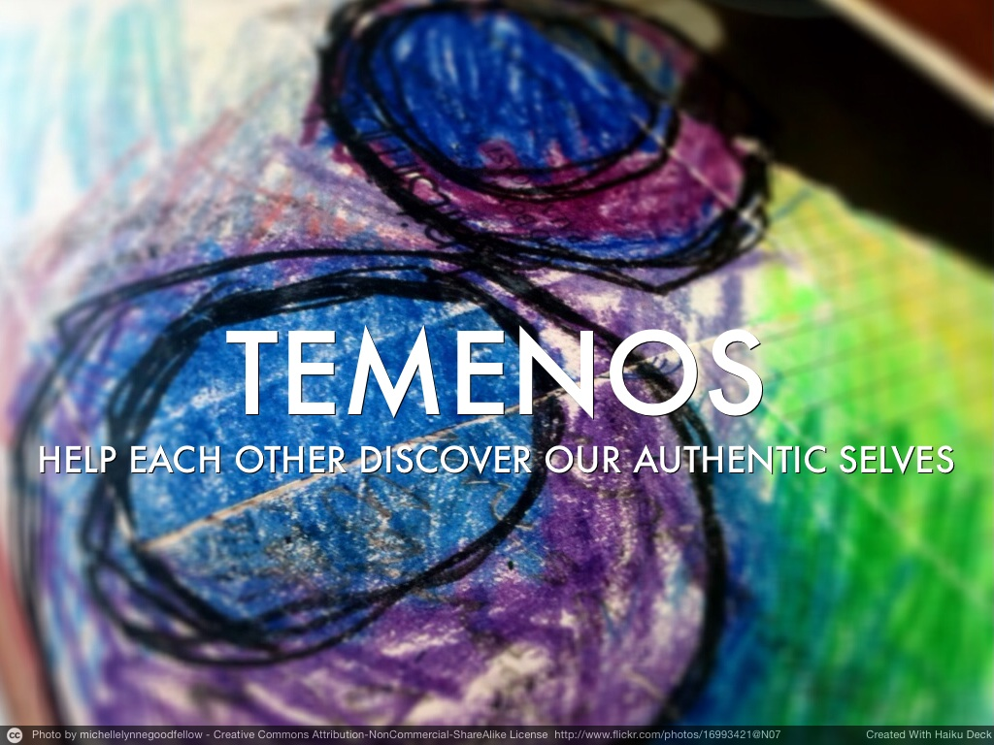
Notes:
Share stories, adapt perspectives.

Slide 44

Photo by swan-t - Creative Commons Attribution-NonCommercial License http://www.flickr.com/photos/35237097247@N01
Created with Haiku Deck
Notes:
You‘ll feel less alone... And feeling alone makes us vulnerable and adds to the shame.

Slide 45
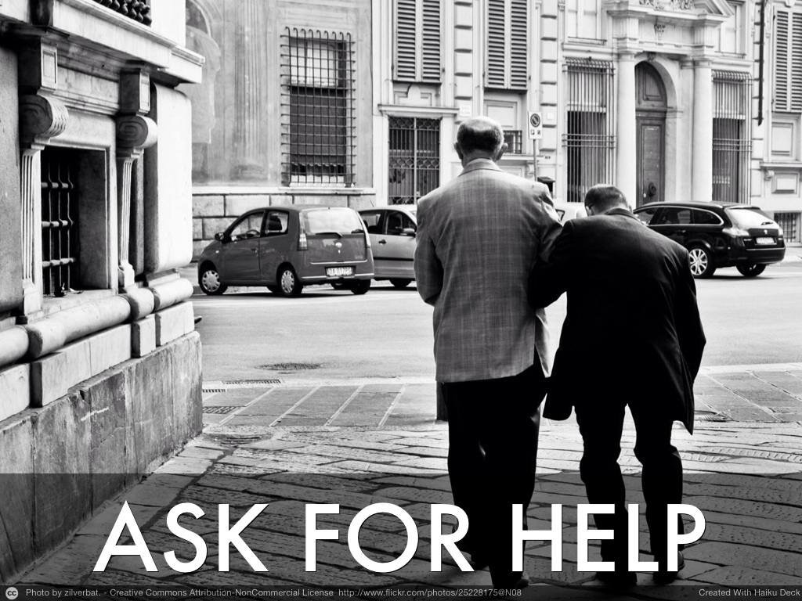
Notes:
Most important ... AFH

Slide 46

Photo by Xjs-Khaos - Creative Commons Attribution-ShareAlike License http://www.flickr.com/photos/8286908@N02
Created with Haiku Deck
Notes:
One tip to improve effectiveness...

Slide 47
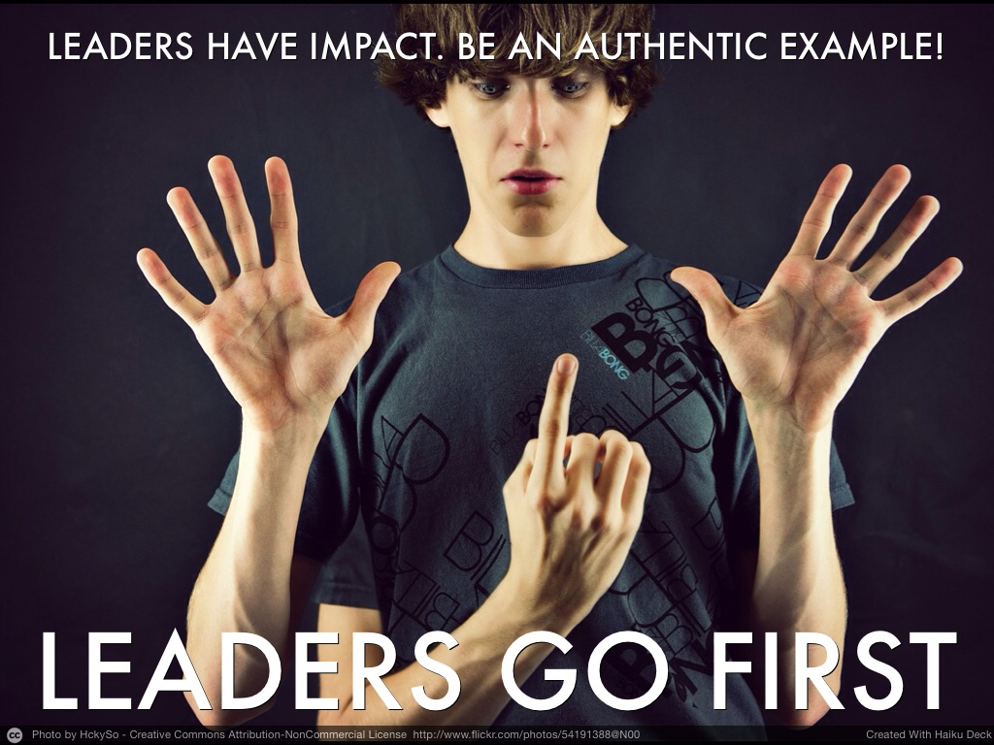

Slide 48
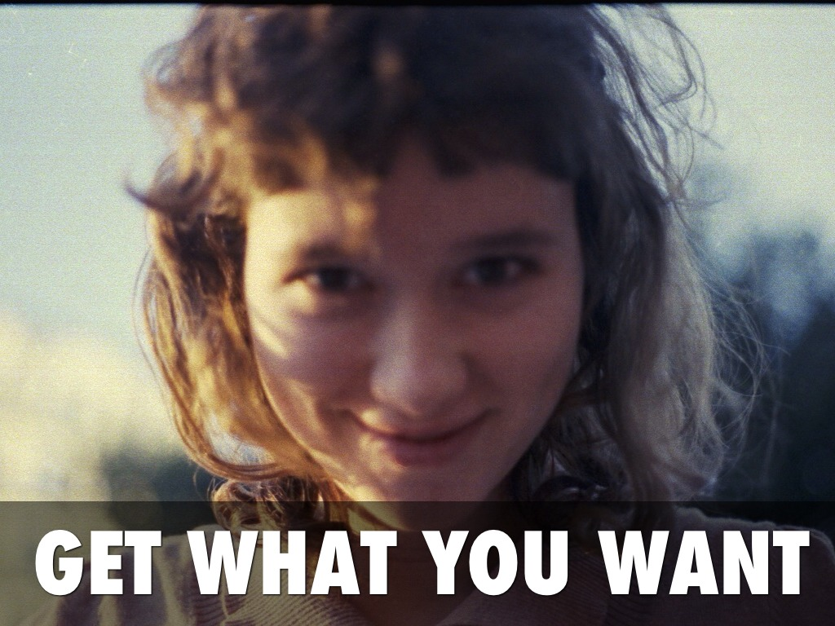
Photo by Amir Kuckovic - Creative Commons Attribution-NonCommercial-ShareAlike License http://www.flickr.com/photos/12389767@N04
Created with Haiku Deck

Slide 49
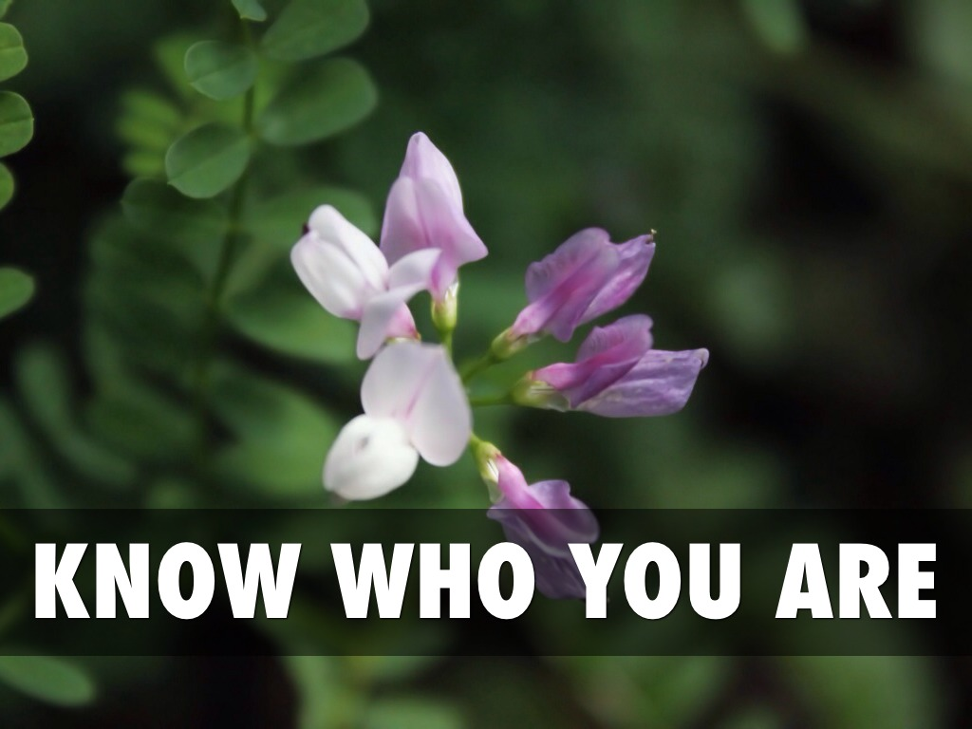
Photo by Jinx_is_weird - Creative Commons Attribution-ShareAlike License http://www.flickr.com/photos/38158875@N07
Created with Haiku Deck

Slide 50

Photo by Taekwonweirdo - Creative Commons Attribution-NonCommercial-ShareAlike License http://www.flickr.com/photos/92283658@N00
Created with Haiku Deck

Slide 51
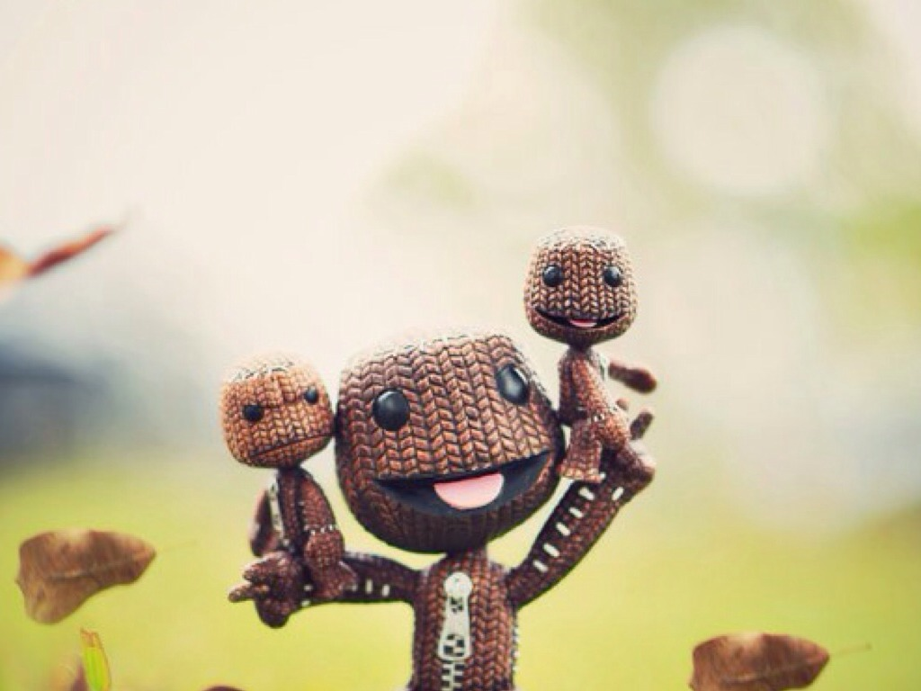
Stay Weird.
Photo by HaniSham™ - Creative Commons Attribution-NonCommercial-ShareAlike License http://www.flickr.com/photos/27471247@N02
Created with Haiku Deck

Slide 52
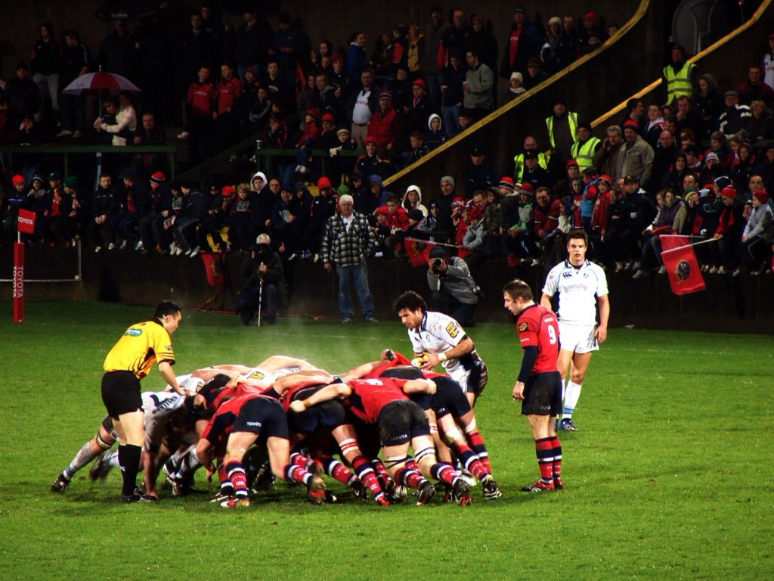
One More Thing:
Photo by royskeane - Creative Commons Attribution License http://www.flickr.com/photos/35764264@N00
Created with Haiku Deck
Notes:
One last thing... If your organisation uses some practices which are inspired by Rugby....

Slide 53
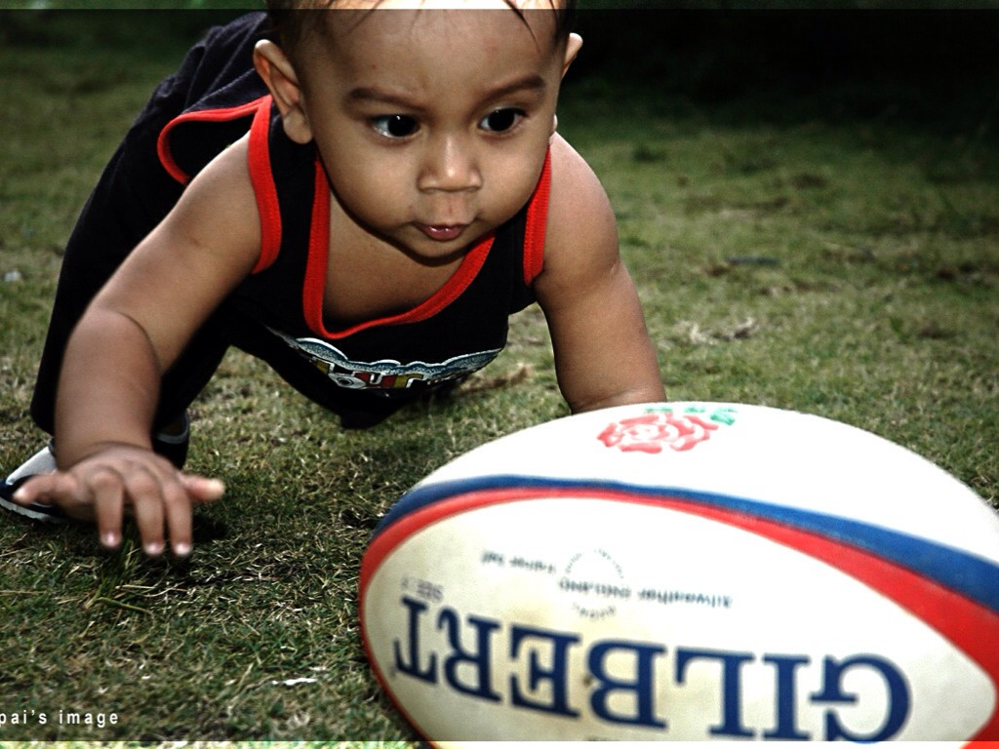
Photo by mdpai75 - Creative Commons Attribution License http://www.flickr.com/photos/30962814@N08
Created with Haiku Deck
Notes:
Focus on the ball.

Slide 54
Reduce Politics — Improve Culture
THANK YOU!
ACE! — 2014 — Krakow — Olaf Lewitz
Licensed under a
Creative Commons
Attribution-NonCommercial-ShareAlike 4.0 International
http://creativecommons.org/licenses/by-nc-sa/4.0/

